Slide 1
Express JS
Web framework for Node.js

Slide 2
What is Express js?
Fast, unopinionated, minimalist web framework for Node.js

Slide 3
Hello world!
var express = require('express');
var app = express();
app.get('/', function (req, res) {
res.send('Hello World!');
});
app.listen(3000, function () {
console.log('Example app listening on port 3000!');
});

Slide 4
Express application generator
npm install –g express-generator
express <app-name>
npm install

Slide 5
Routing
app.get('/', function (req, res) { res.send('root'); });
app.post('/', function (req, res) { res.send('Got a POST request'); });
app.put('/user', function (req, res) { res.send('Got a PUT request at /user'); });
app.delete('/user', function (req, res) { res.send('Got a DELETE request at /user'); });

Slide 6
URL Patterns
Path matching is based on regular expression.
“?” makes a character optional
“/use?r” will match ”/usr” and ”/user”
“+” can make a character repeat
“/use+r” will match ”/user”, ”/useeeeer” and so on

Slide 7
Middleware
Middleware functions can perform the following tasks:
Execute any code.
Make changes to the request and the response objects.
End the request-response cycle.
Call the next middleware function in the stack.

Slide 8
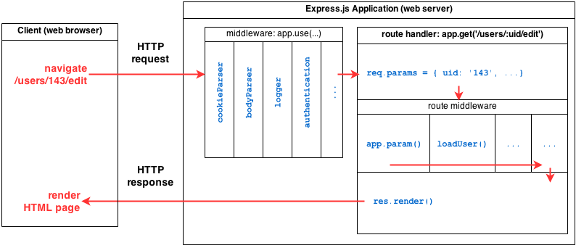
Middleware

Slide 9
Types of Middleware
Application-level middleware
Bind application-level middleware to an instance of the app object by using the app.use()
Router-level middleware
is bound to an instance of express.Router() by using the router.use()
Error-handling middleware
Error-handling middleware always takes four arguments.
Built-in middleware
The only built-in middleware function in Express is express.static
Third-party middleware
Nothing but Node.js modules.

Slide 10
Static files
app.use(express.static('public'));
app.use(express.static(__dirname + '/public'));

Slide 11
Template Engines
app.set('views', path.join(__dirname, 'views')); app.set('view engine', 'jade');
__dirname is always the directory in which the currently executing script resides.

Slide 12
Interesting links
http://www.journaldev.com/7462/node-js-processing-model-single-threaded-model-with-event-loop-architecture
http://jsapp.us/#

Slide 13
Thank You

